Slide 1



A Carbon-Neutral,
Emission-Free,
Particle Accelerator
for Ion Beam Analysis
Dan Faircloth, Olli Tarvainen
ISIS Low Energy Beams Group
UKRI STFC Rutherford Appleton Laboratory
Taneli Kalvas, Ville Toivanen
Accelerator Laboratory
University of Jyväskylä, Finland

Slide 2
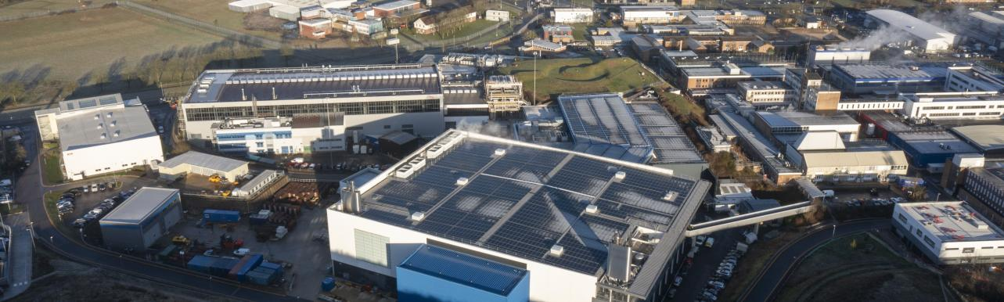
Particle accelerators traditionally use a lot of power…
The only solution is to build a communal heating system that can be switched off when ISIS is running
ISIS uses approximately 11 MW
to produce a 160 kW proton beam
(which is then dumped into the targets!)

Slide 3
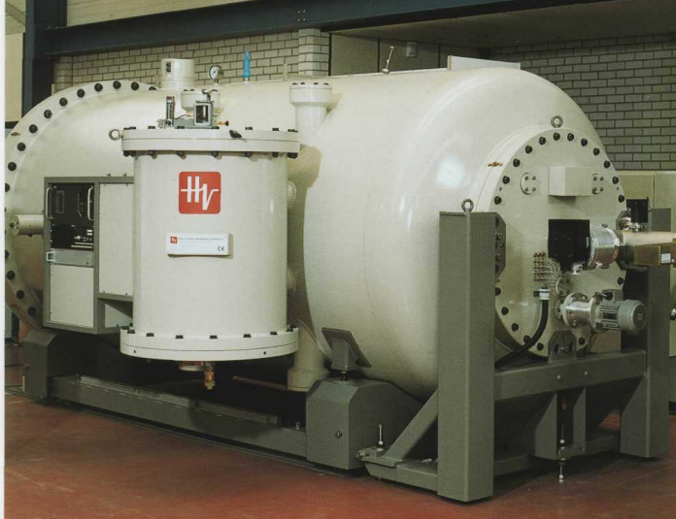

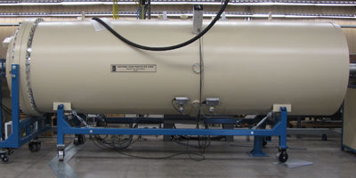

…or require large amounts of SF₆ (for high voltage insulation)
SF₆ is the most potent greenhouse gas:
1 kg SF₆ “lost” = 23 tonnes of CO₂
stays in the atmosphere for 3,200 years
A possible solution is to modify the system to use a modern alternative
e.g.
C4-FN (fluoronitrile) mixture
(O₂ / CO₂ / N₂)
GE and Hitachi
…or use a design that eliminates the need for insulating gas entirely:

Slide 4
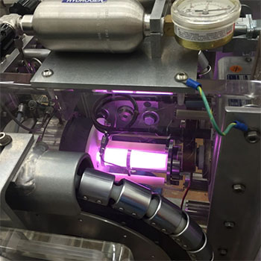

Typical IBA Acceleration Schemes and Sources
“single ended”
high voltage terminal
positive ion beam
e.g. He⁺
sample
very compact and hard to access ion source
RF ion source or
duoplasmatron
1-20 MV
detector
5-8 bar SF₆

Slide 5

Typical IBA Acceleration Schemes and Sources
negative
ion source
“tandem”
double your energy for free
high voltage terminal
e.g. Cl⁻ , H⁻
negative ion beam
positive ion beam
sample
stripper
(gas cell or foil)
A zoo of difficult to use and unstable negative ion sources:
Caesium sputter
Charge exchange
Volume
1-20 MV
detector
5-8 bar SF₆

Slide 6
Emission-Free, Zero-Carbon, IBA Concept:
use high charge state ions = much lower accelerating voltage required
high voltage terminal
high charge state
positive ions
sample
q/m dipole
e.g. Xe27⁺
air insulated (SF₆ free)
high voltage design
ECR ion source
detector
500 kV
This approach obviously rules out using light ions, however material modification and
ToF ERDA and are still possible

Slide 7
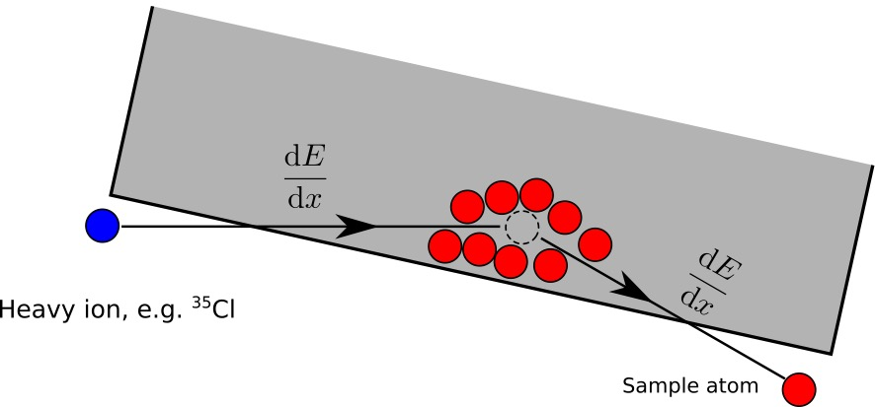
Time-of-Flight Elastic Recoil Detection Analysis (ToF-ERDA)
A method to measure the elemental depth profile in materials
Simple principle:
Bombard the sample with heavy ions
Measure the velocity and energy of the recoiling particles
Use known energy loss in material to obtain depth profile
Lighter than beam particles are ejected, scattered beam
provides information on heavier elements.
Best suited for light elements including H, Li, C, N and O.
These elements cannot be detected using photon-based (x-ray) methods.
Hydrogen is “invisible” to Rutherford Backscattering Spectrometry (RBS), which makes ToF-ERDA unique.

Slide 8
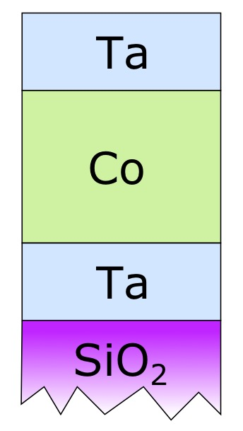
Time-of-Flight Elastic Recoil Detection Analysis (ToF-ERDA)
Useful tool for developing thin-film/surface technologies:
Superconducting RF
Electronic devices
Sensors
Functional surface coatings
Catalytic surface chemistry
Energy applications
Battery technology
…
Example: metal tri-layer on silicon-oxide substrate

Slide 9
Typical ToF-ERDA ion beam requirements
Beam | Energy
^{35/37}Cl | 3 - 6 MeV
^{79/81}Br | 8 - 11 MeV
¹²⁷I | 9 - 16 MeV
The required particle flux at the sample is 1-10 pnA
Lower limit: Reasonable measurement time, typically less than an hour / sample.
Upper limit: The maximum count rate of the energy detector.

Slide 10
… to limit the platform voltage to 500 kV
Ion | Charge state required | Energy
⁴⁰Ar | 6+ … 12+ | 3 - 6 MeV
⁸⁴Kr | 16+ … 22+ | 8 - 11 MeV
¹³⁶Xe | 18+ … 32+ | 9 - 16 MeV
Beam | Energy
^{35/37}Cl | 3 - 6 MeV
^{79/81}Br | 8 - 11 MeV
¹²⁷I | 9 - 16 MeV
we need
1-10 pnA of
these charge states
We need an Electron Cyclotron Resonance (ECR) ion source
it needs to be a permanent magnet based ion source

Slide 11
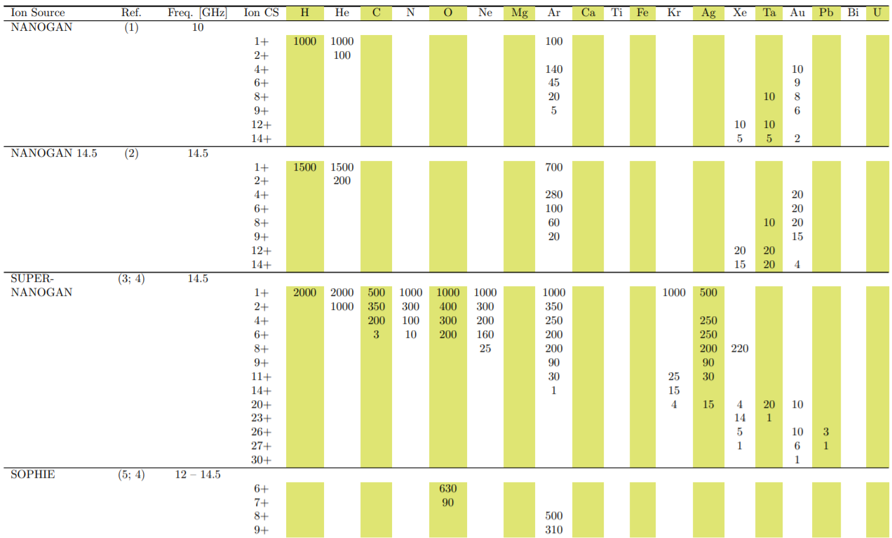
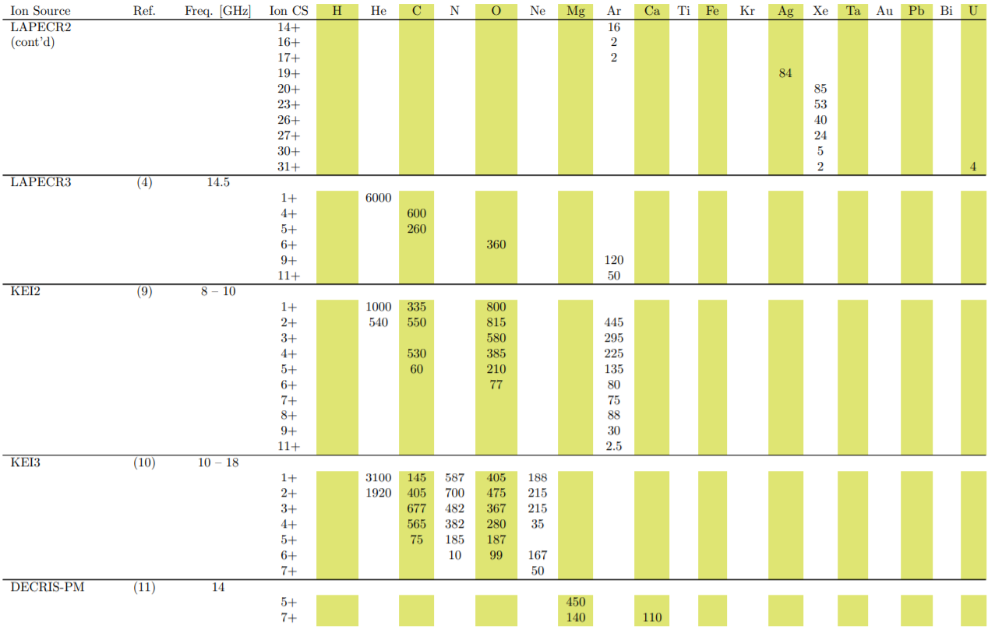
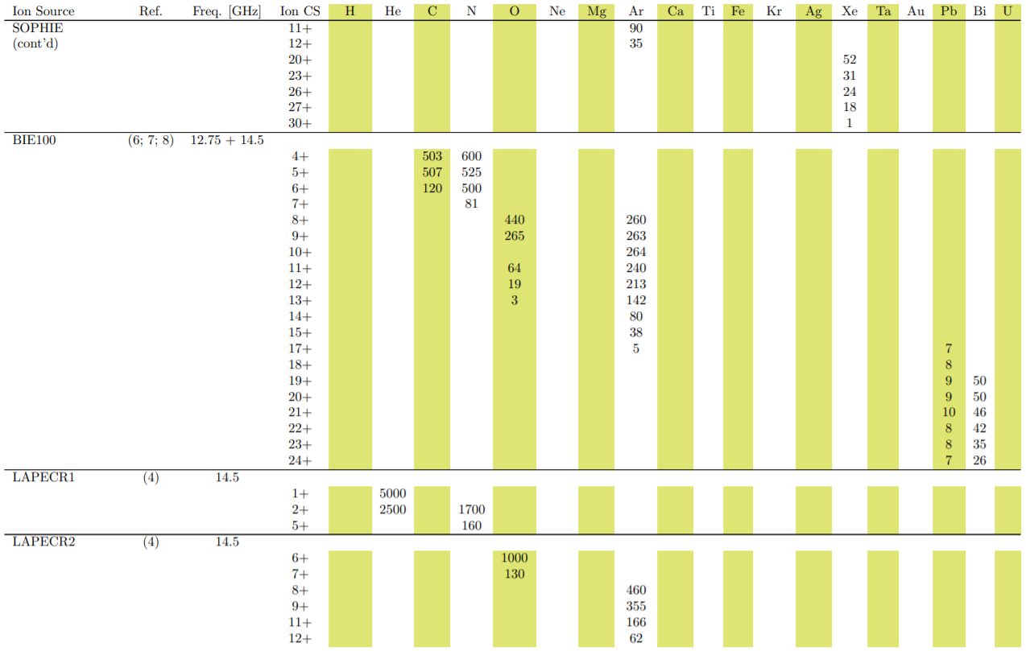
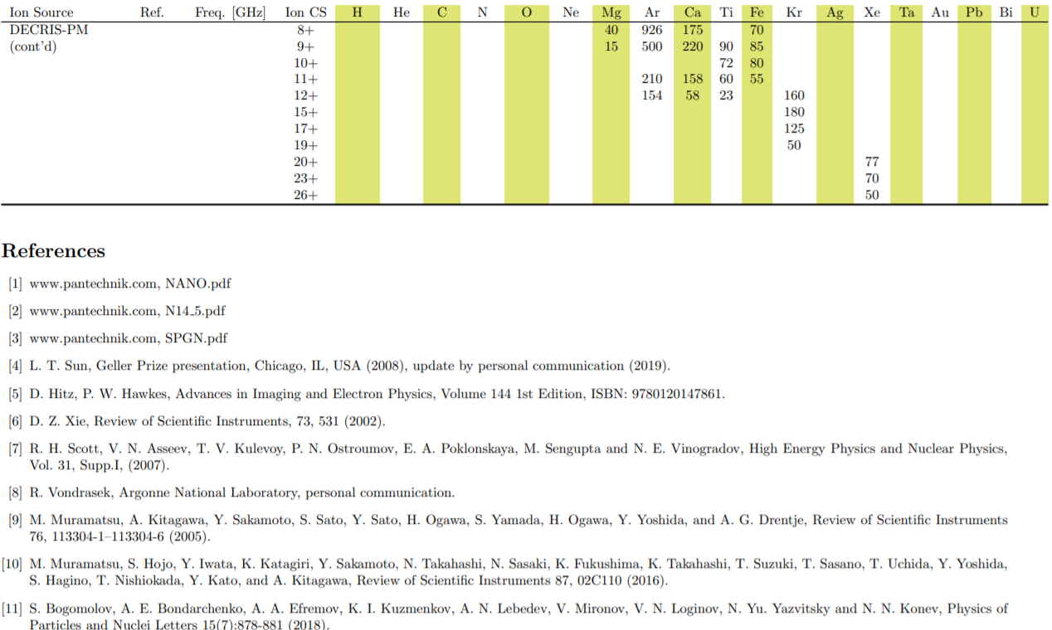
Permanent magnet ECR ion sources
SUPERNANOGAN
DECRIS-PM

Slide 12
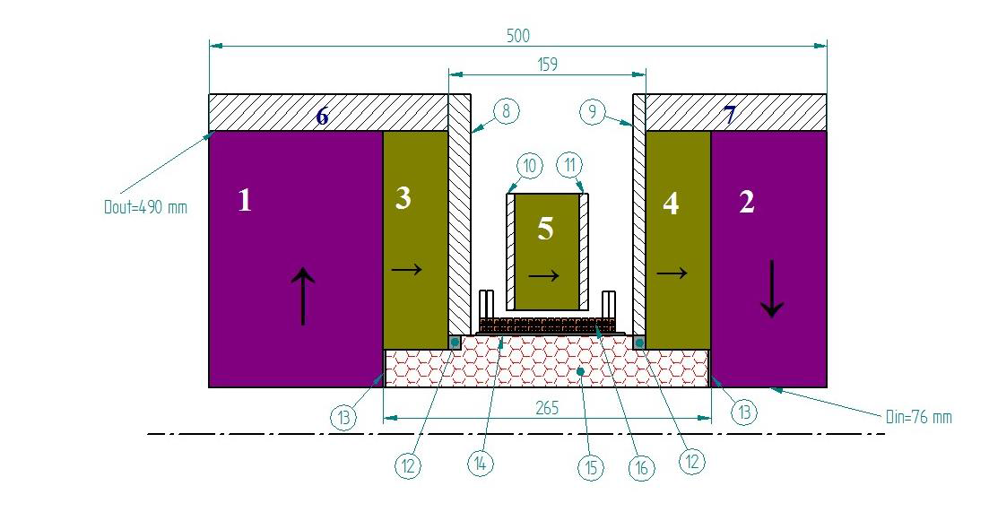
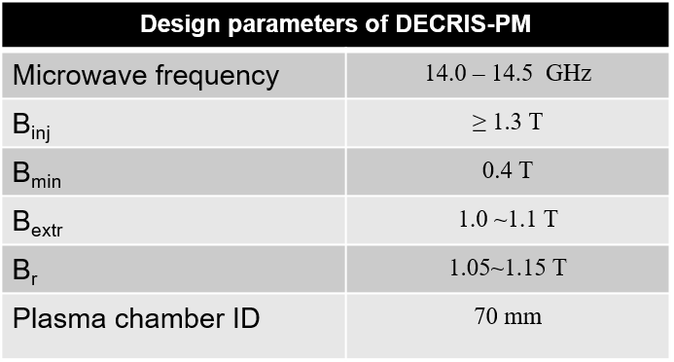
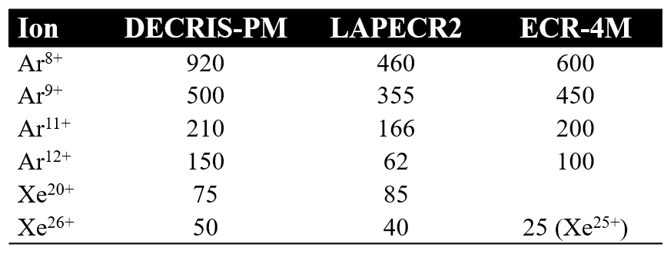
Dubna ECR Ion Source
1~5：PM rings
6, 7：soft iron rings
8~11：soft iron plates
12~14：auxiliary elements,
15：hexapole
16：coil
525 kg of PM material

Slide 13
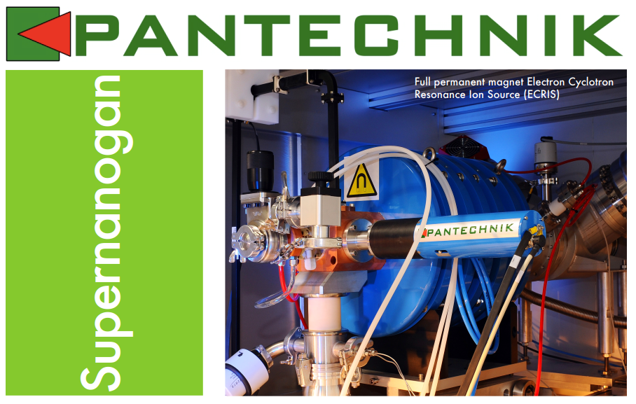
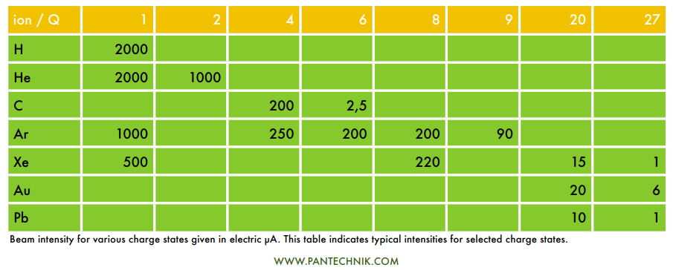
Commercial permanent magnet ECRIS
approx. £1M

Slide 14
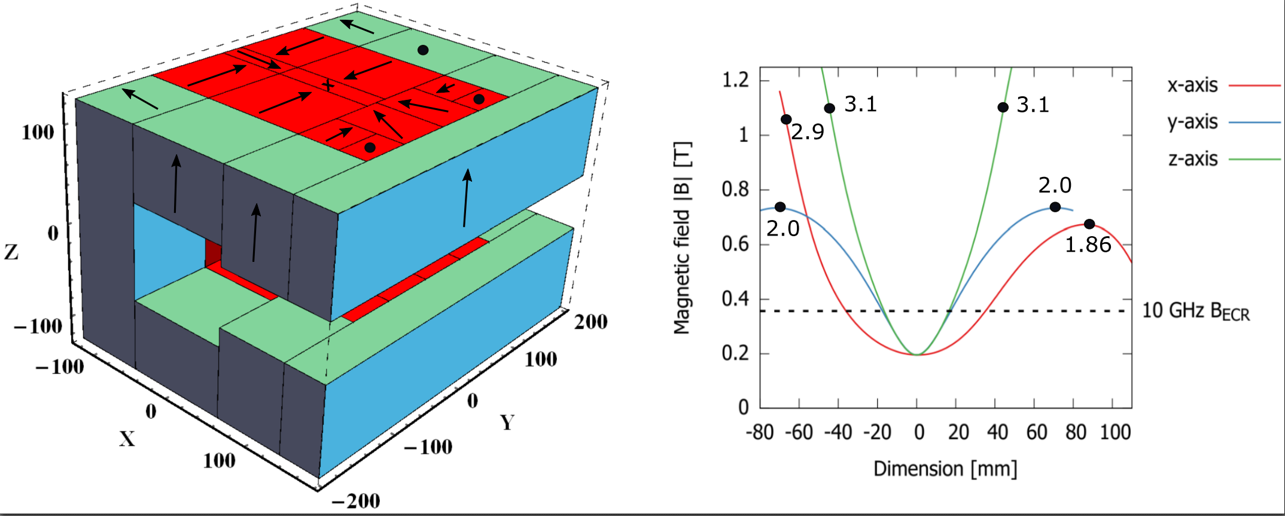
Permanent magnet CUBE-ECRIS
Novel quadrupole minimum-B structure
160 kg of PM material

Slide 15
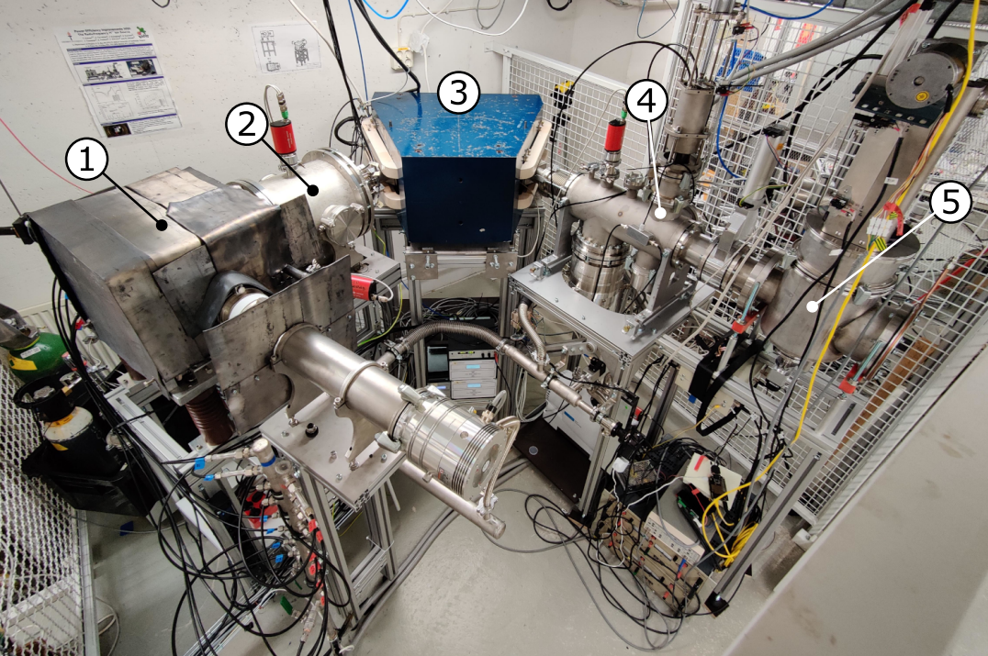
Permanent magnet CUBE-ECRIS
CUBE-ECRIS
Electrostatic quadrupole doublet
m/q-analysis magnet
(4) Faraday cup
(5) Emittance scanner

Slide 16
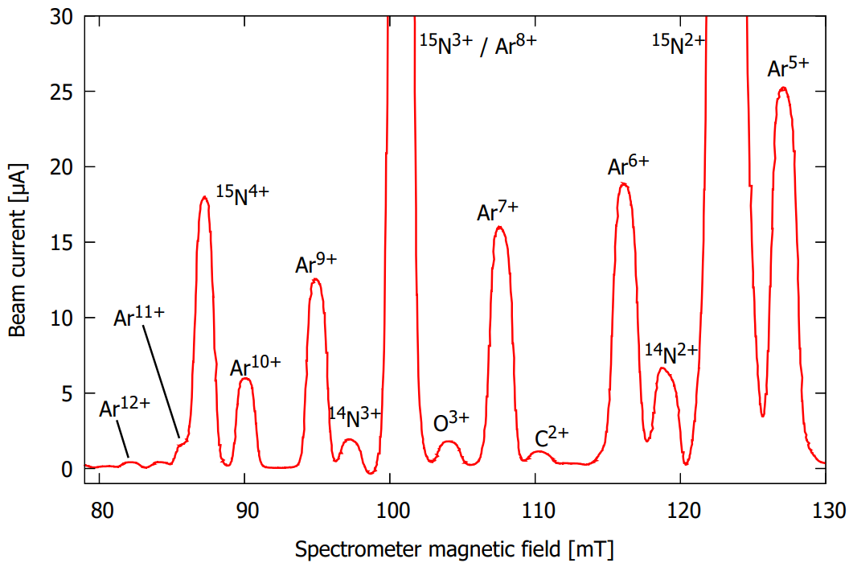
Permanent magnet CUBE-ECRIS
Argon charge state distribution with 15-nitrogen buffer gas to measure Ar¹²⁺ without overlapping buffer gas ions
Charge state | Current [μA] | Flux [pnA]
5+ | 25 | 5000
6+ | 18 | 3000
7+ | 15 | 2140
8+ | - | -
9+ | 12 | 1330
10+ | 5.8 | 580
11+ | 1.5 | 140
12+ | 0.4 | 33
12 kV source potential
TOF ERDA suitable
@ 500 kV

Slide 17
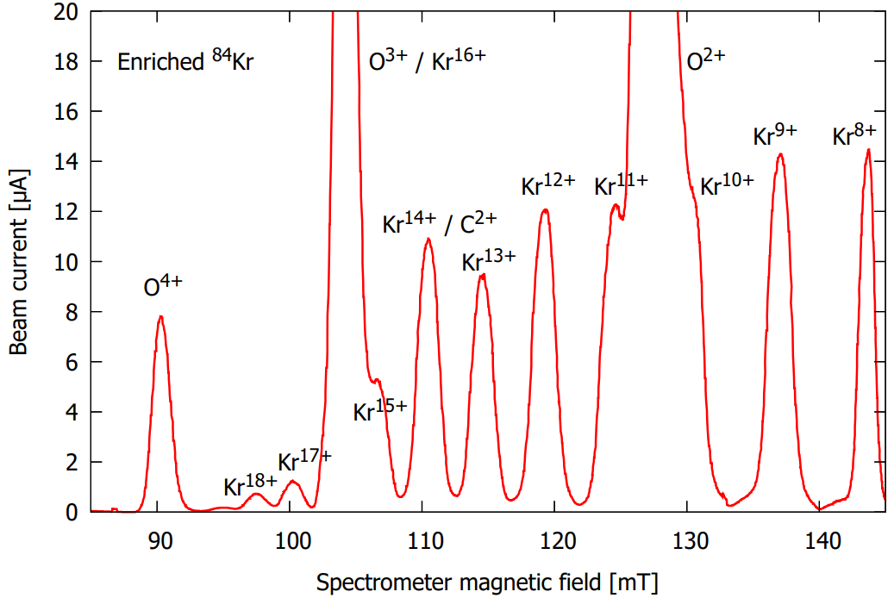
Permanent magnet CUBE-ECRIS
Krypton (enriched 84-isotope) charge state distribution
Charge state | Current [μA] | Flux [pnA]
17+ | 1.25 | 100
18+ | 0.73 | 40
19+ | 0.23 | 12
TOF ERDA suitable
@ 500 kV
(9.5 MeV)

Slide 18
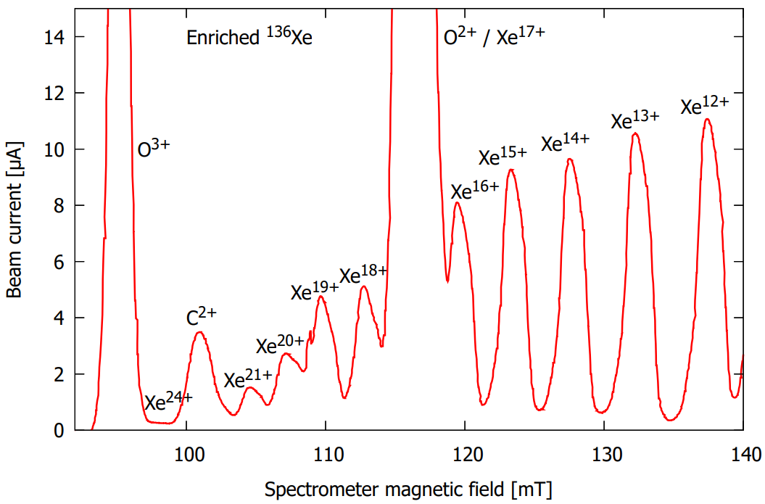
Permanent magnet CUBE-ECRIS
Xenon (enriched 136-isotope) charge state distribution
*Enriched 131-isotope
Charge state | Current [μA] | Flux [pnA]
18+ | 4.9 | 270
19+ | 4.55 | 240
20+ | 2.7 | 135
21+ | 1.5 | 70
22+ | - | -
23+ | 0.5* | 22*
24+ | 0.2 | 8
TOF ERDA suitable
@ 500 kV
(12 MeV)

Slide 19
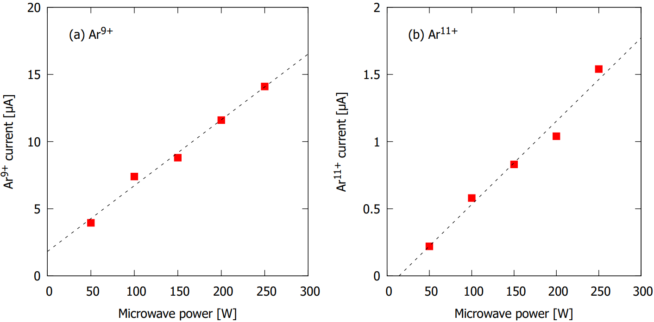
Permanent magnet CUBE-ECRIS
One possibility to increase the beam currents of high charge state Kr and Xe beams is to increase the microwave power.
The high charge state currents are power limited as shown here for argon.

Slide 20
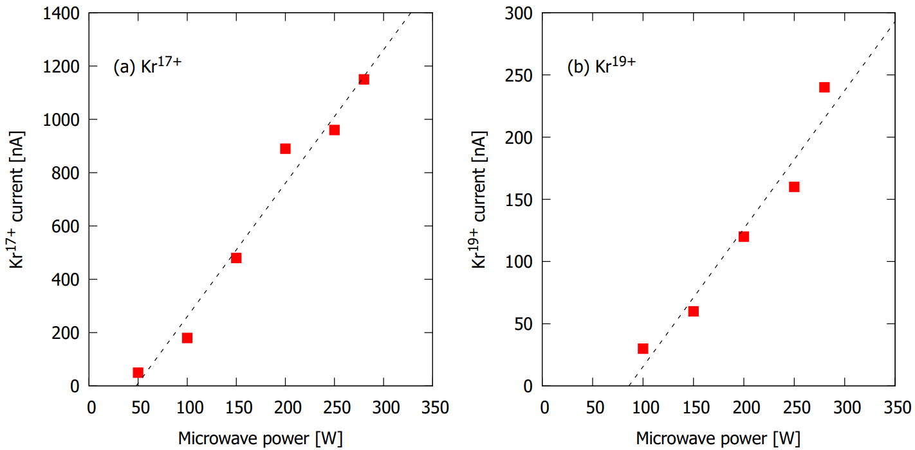
Permanent magnet CUBE-ECRIS
One possibility to increase the beam currents of high charge state Kr and Xe beams is to increase the microwave power.
The high charge state currents are power limited as shown here for krypton (enriched ⁸⁴Kr isotope).

Slide 21
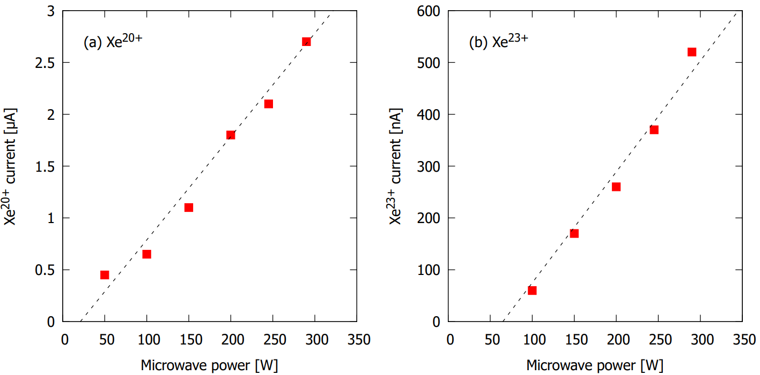
Permanent magnet CUBE-ECRIS
One possibility to increase the beam currents of high charge state Kr and Xe beams is to increase the microwave power.
The high charge state currents are power limited as shown here for xenon (enriched ¹³¹Xe isotope).

Slide 22
Permanent magnet CUBE-ECRIS
CUBE-ECRIS
Electrostatic quadrupole doublet
m/q-analysis magnet
(4) Faraday cup
(5) Emittance scanner

Slide 23


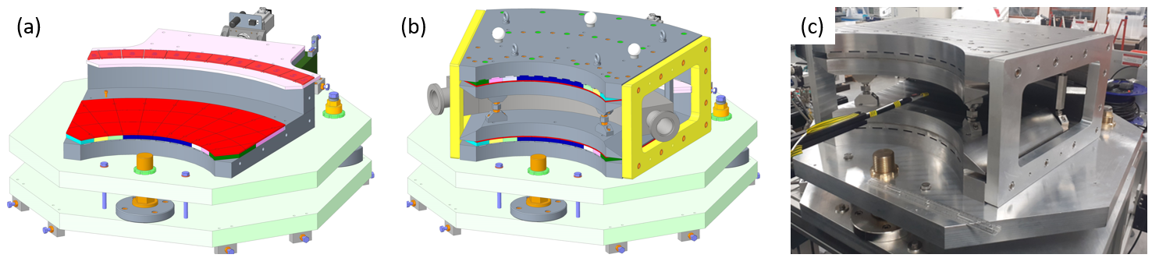


Adjustable field permanent magnet dipole for charge state selection
funded by:
Physics design and simulation
Engineering design and assembly
Field measurement and validation

Slide 24
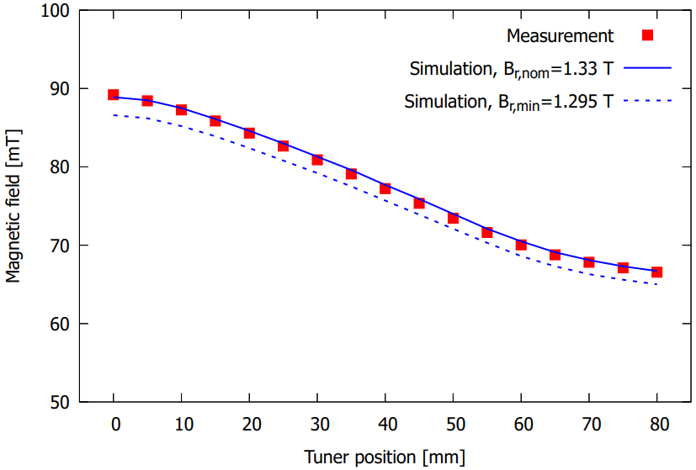
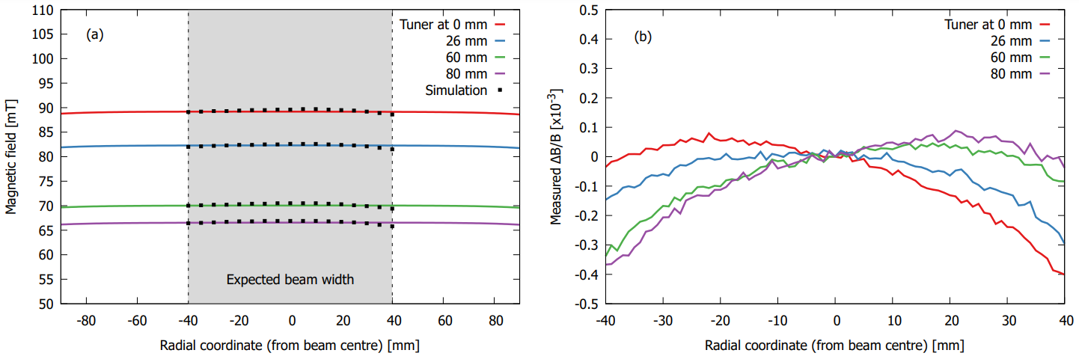
Adjustable field permanent magnet dipole for charge state selection
Perfect match between simulation and
measured field with varying tuner position
Excelllent field uniformity radially across the magnet pole,
ΔB/B < 5x10^⁻⁴ (the specification is 1x10⁻³)
Other potential applications of the magnet:
accelerator based nuclear physics
accelerator mass spectrometry
isotope separation

Slide 25
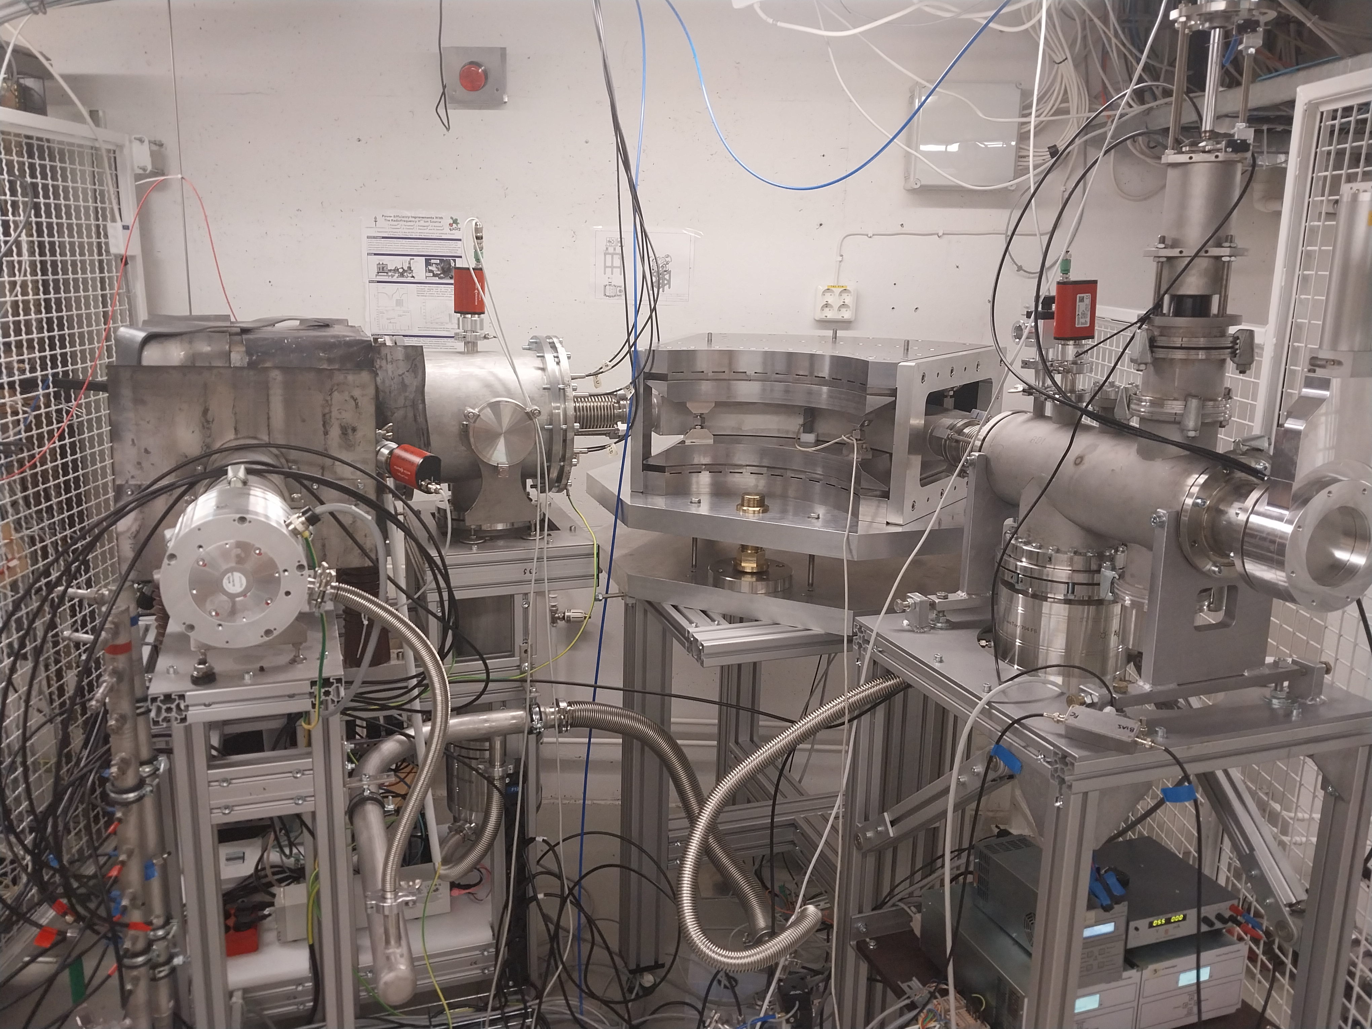
First beam transport tests with the PM dipole – May 2024
PM dipole magnet

Slide 26
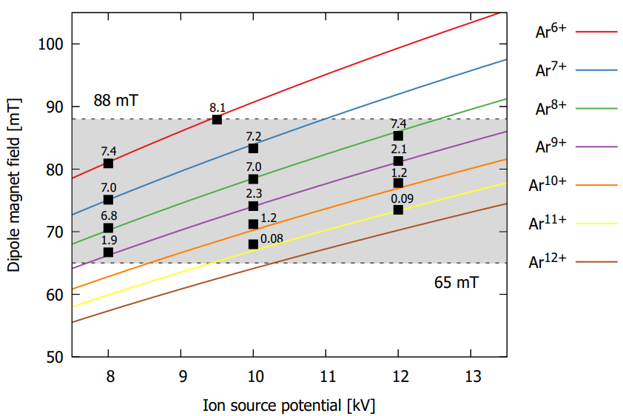
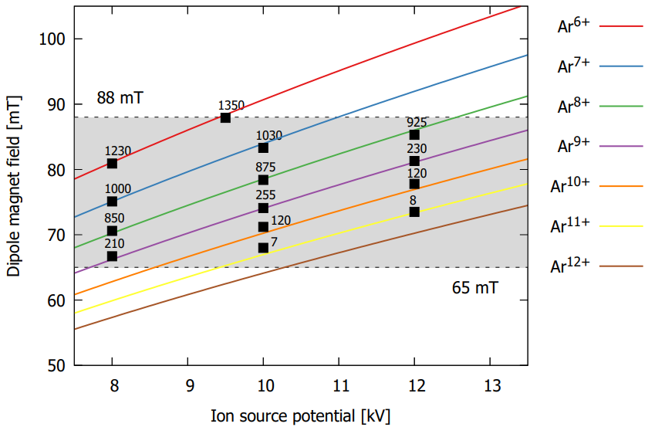
First beam transport tests with the PM dipole – May 2024
Argon beam currents in μA
Argon beam currents in pnA

Slide 27
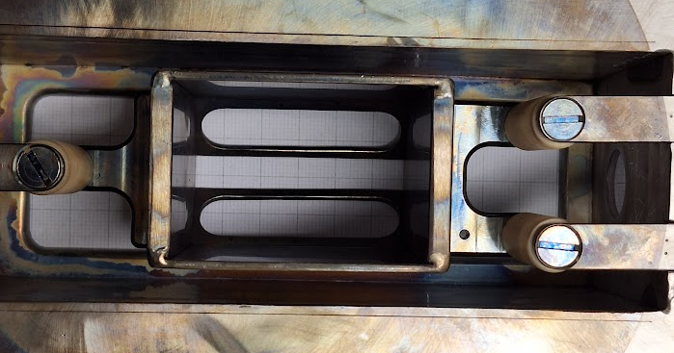
First beam transport tests with the PM dipole – May 2024
Argon beam currents are lower than with the electromagnet
This is due to lack of optimisation:
No double frequency heating
Higher than normal drain current
Beam losses due to severe extraction misalignment
Beam transport simulations of the whole LEBT to confirm
the effect on total transmission
Puller electrode offset and rotation wrt the extraction slit

Slide 28
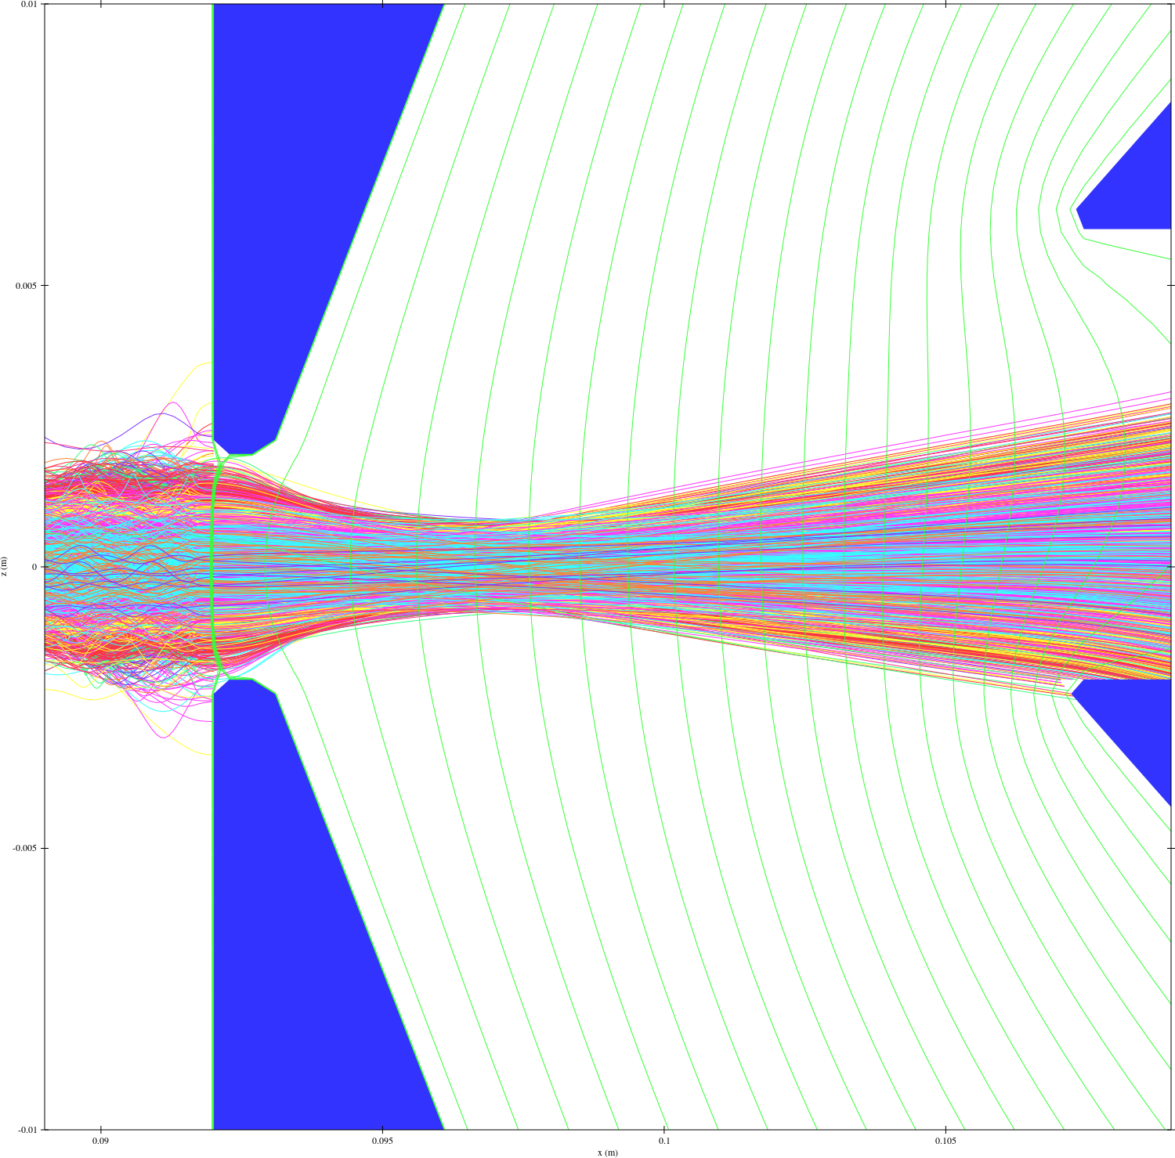
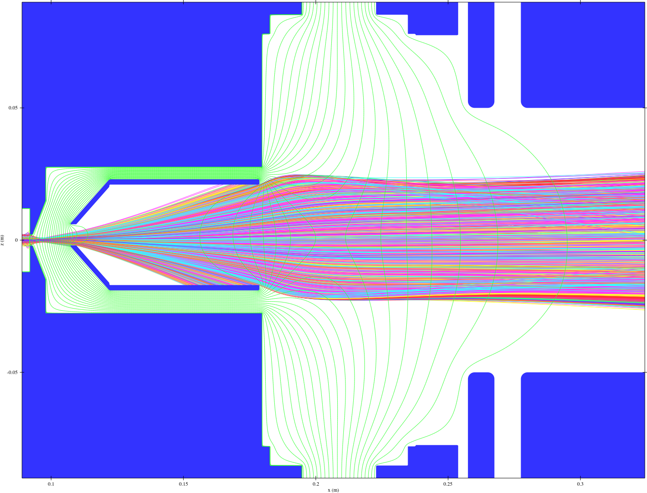
First beam transport tests with the PM dipole – May 2024
Puller electrode offset and rotation wrt the extraction slit
Asymmetric beam losses in the puller electrode
and poor quality beam into the LEBT

Slide 29
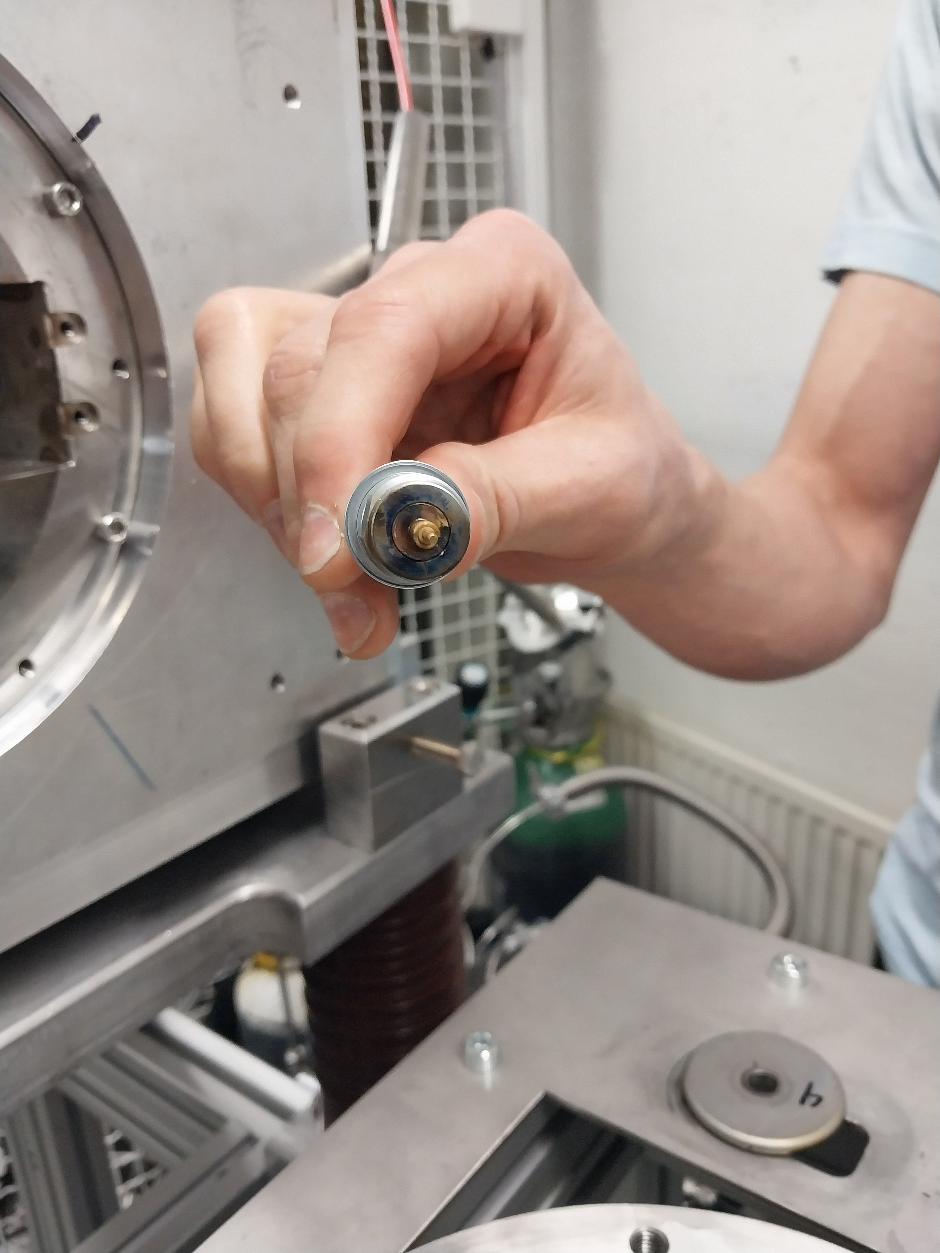
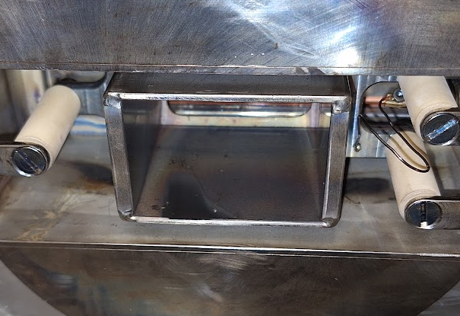
First beam transport tests with the PM dipole – May 2024
Beam burn mark matching the simulation with puller offset
Beam induced sputtering
coating of the puller feedthrough
failure ending the experiment
Requires correcting the misalignment and
changing the puller feedthrough location

Slide 30
Next steps
Continue optimisation of front end
Develop the rest of the system

Slide 31

Emission-Free, Zero-Carbon, IBA Concept – Required Components
Safety, control and integration
Commercially available accelerating column
Battery power on platform
high charge state
positive ions
500 kV
DC
sample
q/m dipole
e.g. Xe27⁺
ECR ion source
detector
Commercially available experiment station
Commercially available post insulators

Slide 32
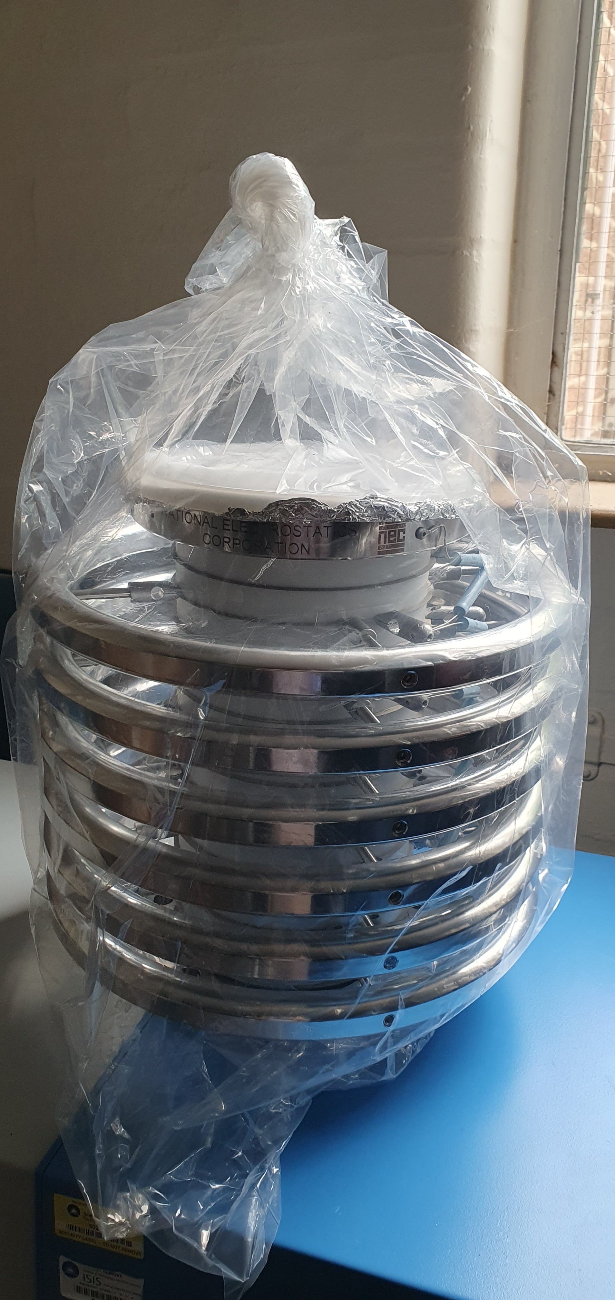
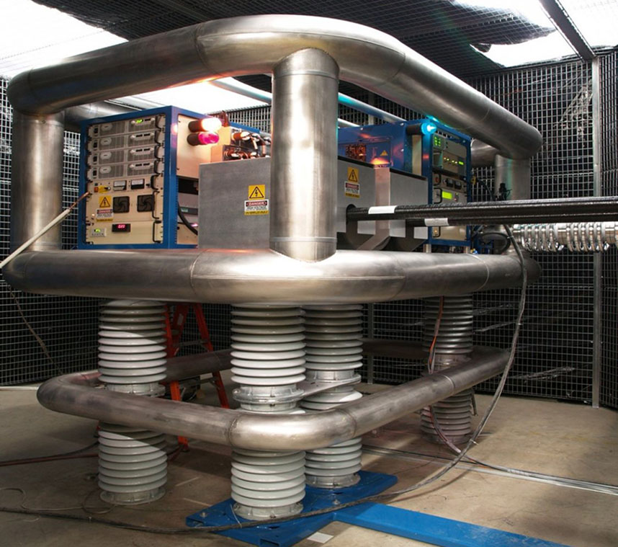
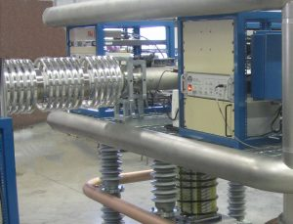
5 x 100 kV NEC air-insulated acceleration tubes received (100 W leakage power)
500 kV NEC

Slide 33
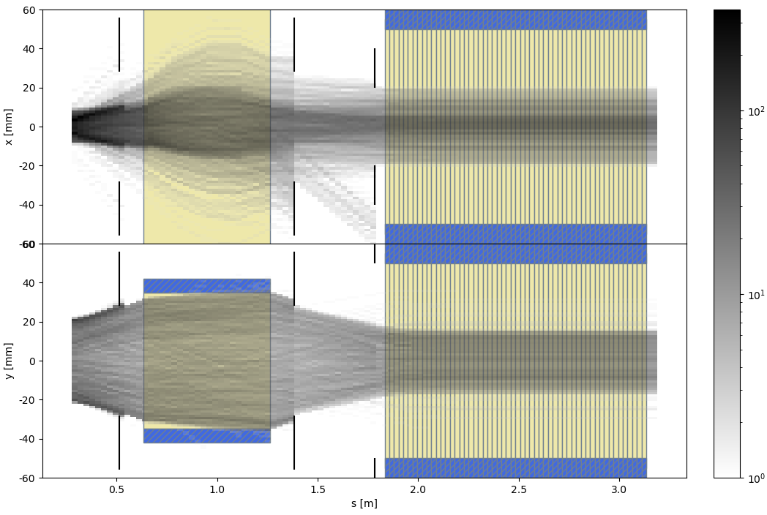
Beam transport simulations
Taneli Kalvas, University of Jyvaskyla
Same overall transport efficiency for higher charge states - 5 MeV Ar¹⁰⁺
PM dipole
500 kV acceleration tube (NEC)
Ar¹⁰⁺
Ar¹¹⁺

Slide 34
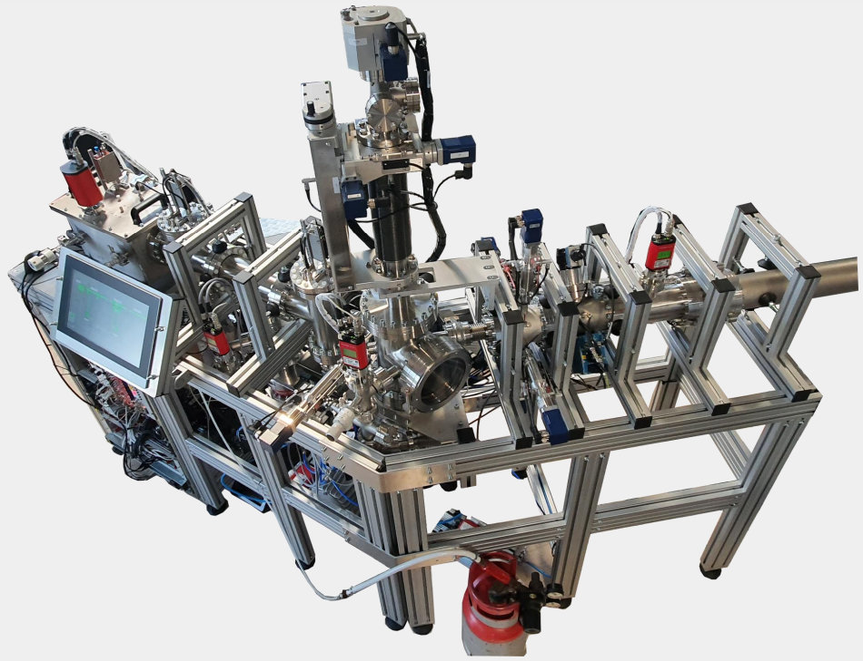
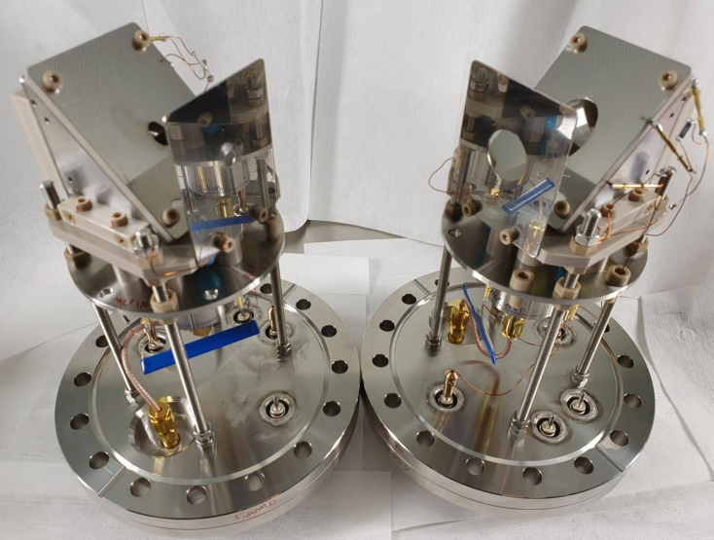
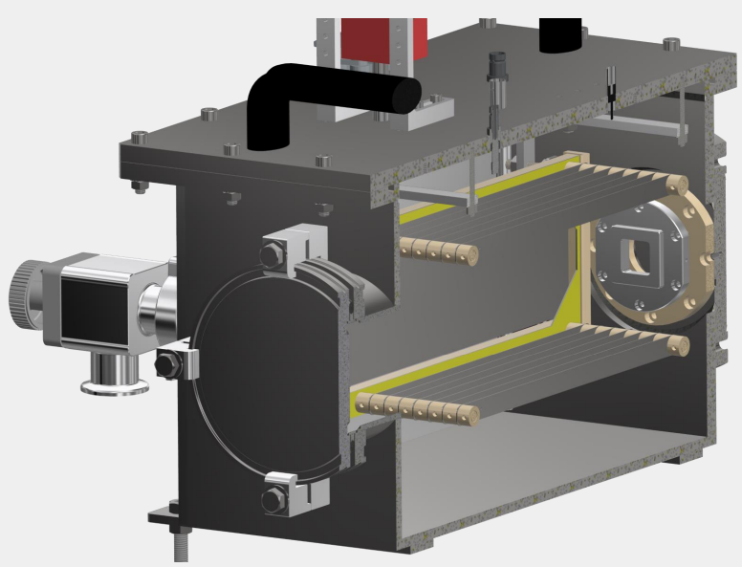
Modern ToF-ERDA tool:
state-of-the-art hydrogen detection
Efficiency
automation options
University of Jyvaskyla
Courtesy of Mikko Laitinen, University of Jyvaskyla

Slide 35
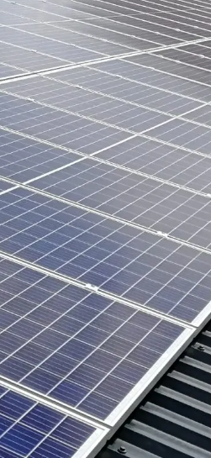
Carbon Neutral!
24x7 base load: 2 kW
+ when operating: 1.5 kW
Operating 8 hours/day
5 days/week
= 20,000 kWh per annum
Based on UK average:
11 m x 11 m of solar panels required
(approximately the building footprint)

Slide 36
Summary
Power consumption low enough to use 100% local solar
Zero emission - SF₆ eliminated
Reliable, flexible and stable ion source
Reduced maintenance
Turn-key/push button system
A critical tool for developing thin-film/surface technologies

Slide 37
Thankyou Questions?

